Slide 1

Common Sense Application
By Joseph Hammer, Darron Herbert, Dominic Nolt, Jason Renna, Tyler Robinson, Nicholas Scaramuzzi, and Dylan Shapiro

Slide 2
About the company
Common Sense is owned by Kathy Lenox and Michael Hammer
The business sells Common Sense, the persistent antimicrobial hand sanitizer and home/work treatment packages
As we scrambled for ideas, on what to develop for senior project this seemed like the perfect opportunity

Slide 3
Our Team
Joseph Hammer
Darron Herbert
Dominic Nolt
Jason Renna
Tyler Robinson
Nick Scaramuzzi
Dylan Shapiro

Slide 4
Division of Labor
Darron Herbert - integrated the Weather functionality, includes getting location information from the user and displaying the correct information from a third party API. Also tested for bugs.
Dominic Nolt - connected the Android Application to the database using PHP. Created the functionalities such as login, register, passwords, and storing user information. Key to the framework of the in-app navigation. Aided in Profile development.

Slide 5
Cont.
Jason Renna - used geocoding to implement the Map feature that allows the user to view stores and treated areas. This included location listeners to grab user’s exact location.
Tyler Robinson - developed and maintains the application’s MySQL database. Involved in creation, structuring, connecting the tables and views, and creating a user friendly Location Manager.
Nick Scaramuzzi - aided in the research for multiple features of the application, coded the app’s Estimation feature, tested for bugs, and worked on numerous pieces of documentation.

Slide 6
Cont.
Joseph Hammer - implemented the Profile, Store, and Treatment Estimate. These give users the ability to change their settings and buy products.
Dylan Shapiro - created the automation for web mining news articles to upload to the News feature of the application. The backbone to the functionality of the Widget.

Slide 7
Communication
As a group we actively met each week multiple times either during class time or we utilized the Rowan Campbell library
Additionally we used tools such as Google Drive, Slack, and GitHub
On multiple occasions we met with our stakeholders, Kathy Lenox and Michael Hammer.
Monthly meetings with Dr. Baliga who was included in the teams GitHub and Slack.

Slide 8
Key components of the application
Give users access to important health information in the form of news
Allow users to be able to view the weather and possible effects it may have on health
The ability for the user to purchase Common Sense and get treatment estimates.

Slide 9
Cont.
Ability for the user to access their account settings.
A map feature that provides the ability to show where it can be bought
Additionally this will also allow the user to be able to identify treated locations

Slide 10
Location Manager Application
Provides simplified way to manage location information
Administrators will not need to access MySQL directly to add, update, or remove locations

Slide 11
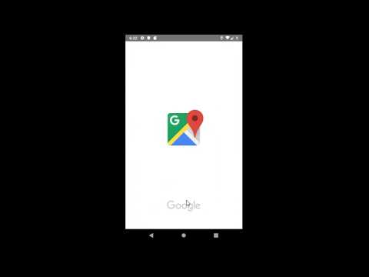
Common Sense App Video

Slide 12
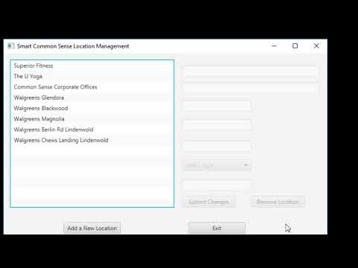
Location Manager Video

Slide 13
Decision making
All software development processes must begin with brainstorming
Originally we decided that it may be best to code in Google's mobile app SDK, Flutter
As a team we did not take this path because of limited experience
We decided to take the route of coding on android studio, This being the better option because we all have experience coding in java over the course of our years at Rowan

Slide 14
Cont.
Another difficult decision of our design process was deciding on the division of labor based on our own individual strengths and our own personable opinions on what we would like to accomplish
Deciding how to handle the backend portion and authentication/security

Slide 15
Technology Stack
The front end of the application was developed in Android Studio using Java.
The interface utilizes XML for its layout and design.
Since the application is being developed for android devices we are using a combination of emulated hardware (android devices).
This is being done to test the software.

Slide 16
Cont.
The weather for the application is obtained through OpenWeatherMap API.
The map was obtained using the Google Maps API.
As for the backend of the application we choose to have the database developed in MySQL and the data is linked to the application using PHP code.

Slide 17
About the backend
Accounts can be created by using a Google account
Security is important! We only store details the app will specifically use, first name, last name, zip code, and their accountID.
Passwords are stored in the database as a hash value so they are kept private and safe.

Slide 18






Screens of the application
LOGIN SCREEN
NEWS FEED
WEATHER
THE MAP
THE STORE
PROFILE PAGE

Slide 19
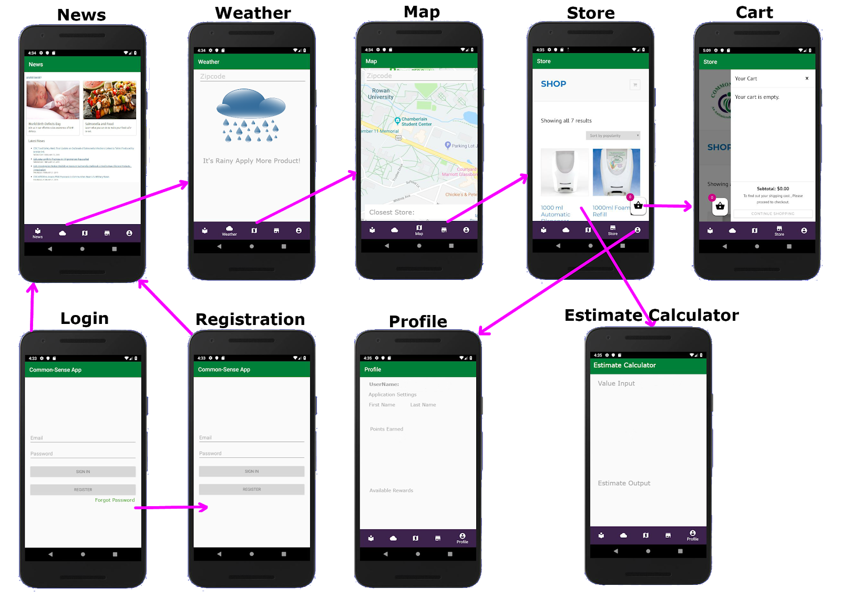
Flow Diagram

Slide 20
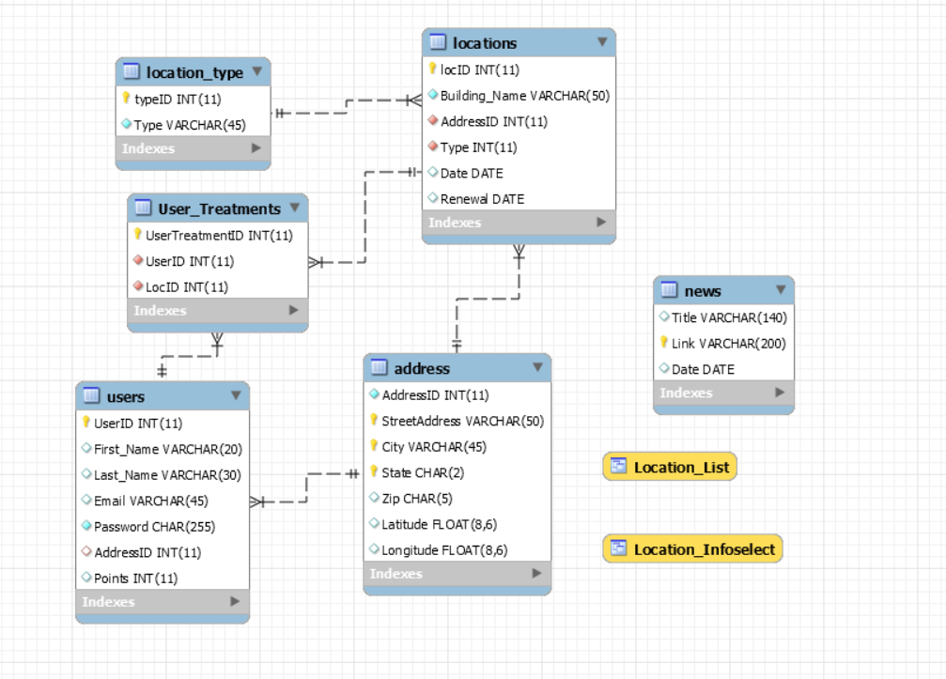
Database Schema

Slide 21
Login
When the application is opened the user is asked to login
First time users will register an account using their google account
Once they have successfully registered or logged in they will be directed to the news screen

Slide 22
News Feed
This portion of the application features the web crawler developed in python
This web-crawler pulls the news from two main websites the FDA and CDC.
It is updated on a 24 hour schedule, and provides links to the main articles

Slide 23
Weather
Is obtained using the OpenWeatherMap API, which gives us the ability to determine the users location
Additionally this allows us to obtain a variety of additional information
With this information we use it to determine health risks related to current weather conditions

Slide 24
Map
Is obtained using Google Maps API
Shows users where they purchase Common Sense
As well as locations that have been treated by the product

Slide 25
Store
Pulled from the smartcommonsense website
The user has access to the online store where they can view and purchase products

Slide 26
Profile
Contains the user’s personal settings
Gives the user the ability to change these settings
Provides a link to the Treatment Estimate

Slide 27
Treatment Estimate
The same formula the company uses
Important to know that this feature still will require a service technician to determine the true cost

Slide 28
Widget
Utilizes the same information from the News Feed to provide similar functionality on the user’s home screen
Can be added, removed and resized outside of the application
It is updated on a 24 hour schedule, and provides links to the main articles, as well as a link to the app itself

Slide 29
Location Manager
Utilizes JCrafts JSch to establish an SSH connection to the server
Utilizes MySQL JDBC to connect to the MySQL database after connecting to the server
Uses a combination of prepared statements, views, and stored procedures to retrieve, update, and insert data

